Slide 1
OSCE
By QEH
JCM – 4 April 2018

Slide 2
Q1
F/47
Ca cervix, depression
Allergic to Flagyl, flu medication, Transamine, Clindamycin
Attended at 0210 for headache
On & off for 3 months but get worse that night
Vomited 10 times
CTB

Slide 3
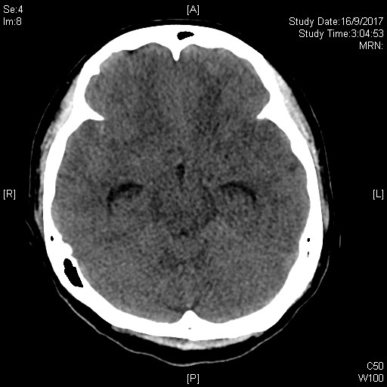
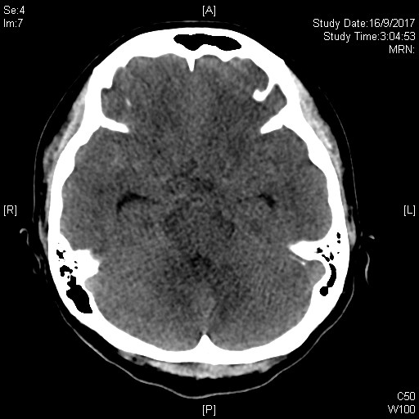
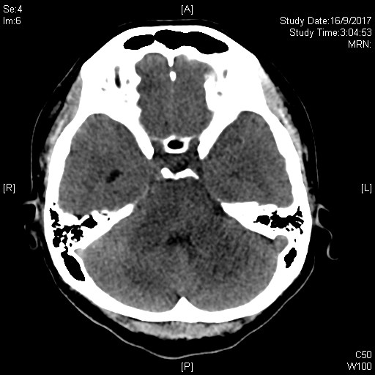
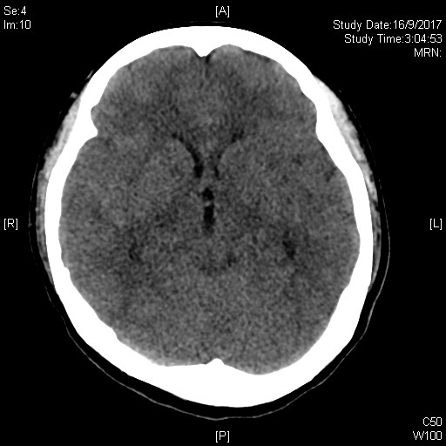
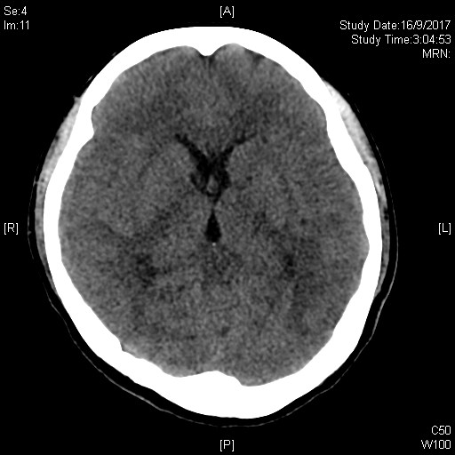

Slide 4
Questions
Name 4 CT abnormalities? (4)
Which part of the ventricle is most sensitive to increase CSF pressure – name one? (1)
What is the commonest cause of SAH? (1)
What are the TWO most common location for non-traumatic cause? (2)
Apart from diagnosis, what information the CT findings may convey – give TWO? (2)

Slide 5
Answers
4 CT abn
  Diffuse cerebral edema
  Dilated Lateral ventricles & Dilated third ventricles – disproportionately compared to the sulci.
  Effaced Sulci & Basal cisterns.
  Right Sylvian fissure and right middle cranial fossa hyperdensity
Temporal (or inferior) horn of lateral ventricle
Rupture of saccular aneurysm
2 common locations
  Middle cerebral artery bifurcation
  along the anterior communicating artery
Other CT info
  Prognostic info - presence of localized clots in the subarachnoid space are correlated with a higher incidence of delayed symptomatic arterial spasm
  Need for operative intervention e.g. decompression surgery

Slide 6
Q2
M/25
slipped and fell in Gym room
Landed on right fist

Slide 7
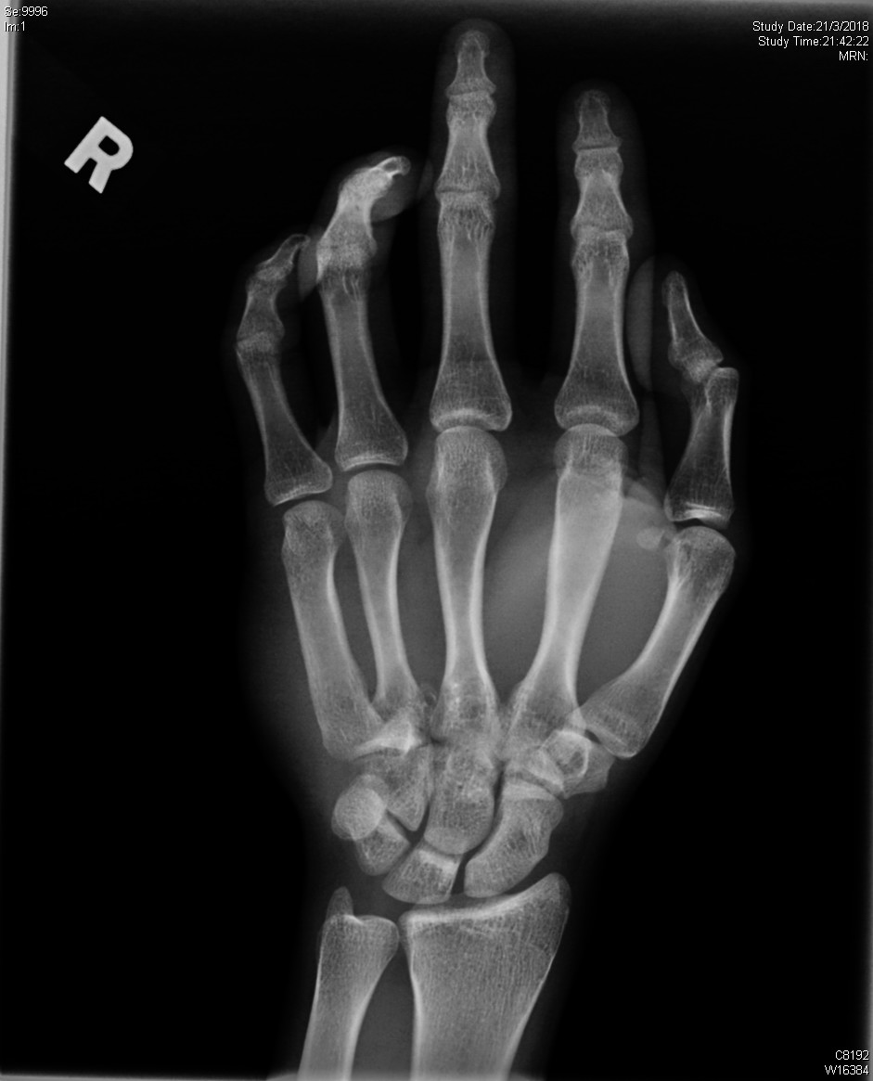
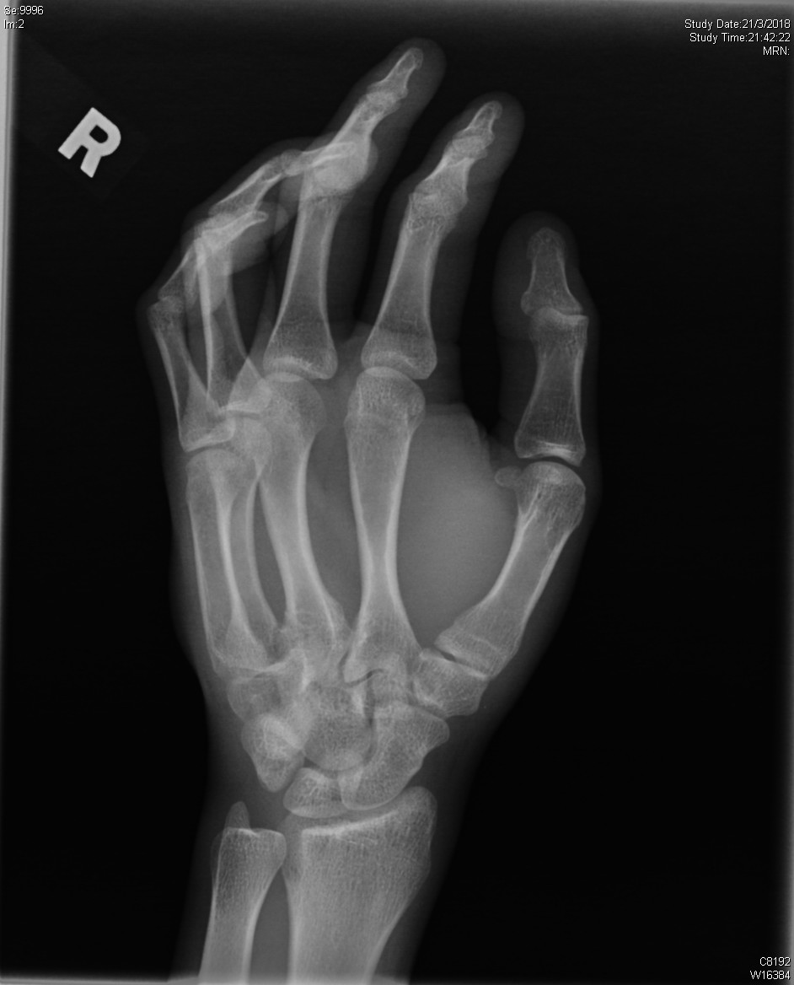
XR R hand

Slide 8
Questions
Name the carpal bones, in order (proximal & distal, medial to lateral) (2)
What are the TWO XR abnormalities? (2)
What additional view may help? (1)
What is the diagnosis? (1)
How is this sort of fractures classified? (2)
What is the treatment for this patient? (2)

Slide 9
Answers
Scaphoid, Lunate, Triquetrum, Pisiform, Trapezium, Trapezoid, Capitate, Hamate
X-ray abn
  Obliteration of joint line of hamate-4th Metacarpal bone
  Radiolucent line over dorsal part of distal hamate body
Lateral/ carpal tunnel/ reverse obligue
Fractured hamate with dorsal dislocation of right 4th CMCJ
Milch classification: fractures of the hook or the body
Open reduction and internal fixation

Slide 10
XR R hand

Slide 11
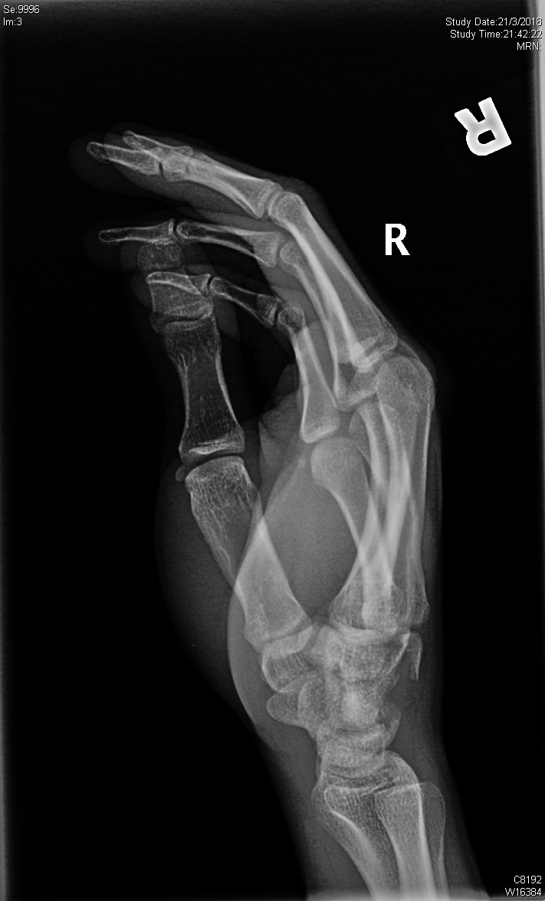

Slide 12
Q3
F/80
Rheumatoid arthritis on Leflunomide, Methotrexate
Bilateral total knee replacement done
Presented to A&E for left thigh pain after slipped and fell
She was discharged after assessment but reattended 4 hours later for left thigh pain after falling from sofa

Slide 13
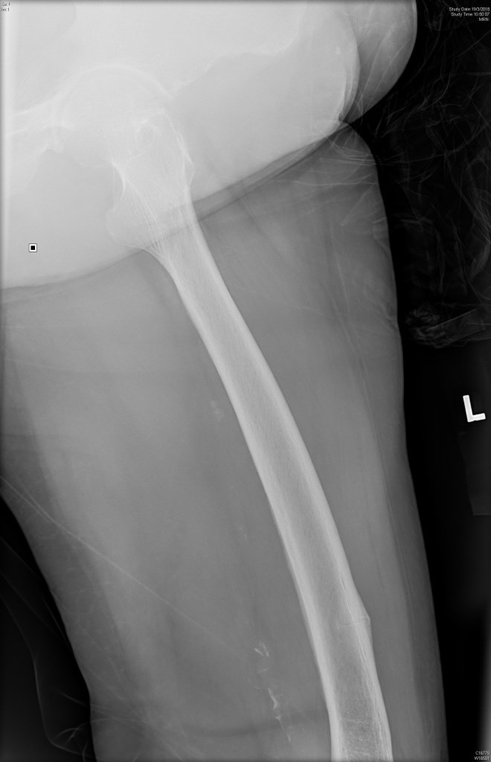
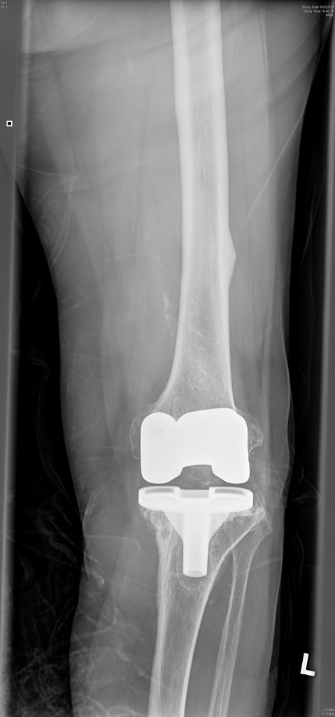

Slide 14
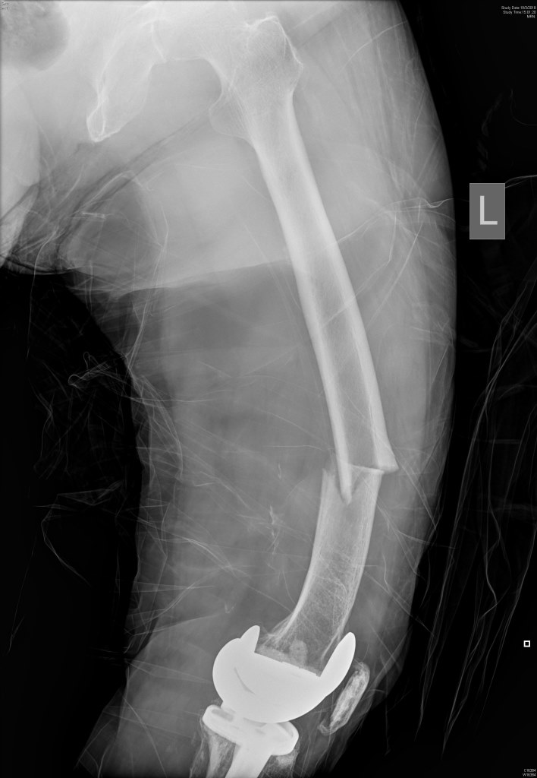
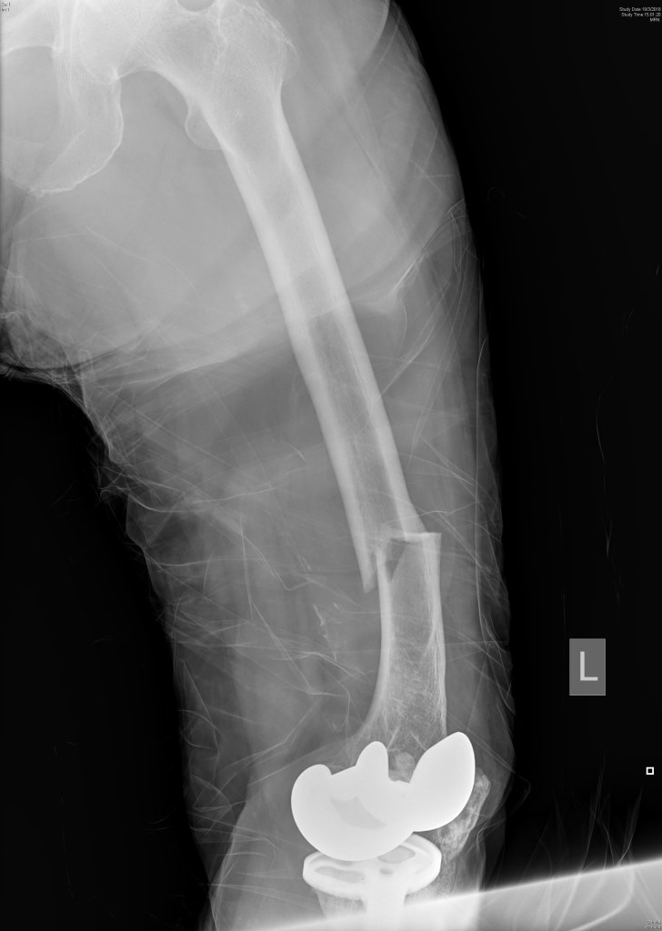

Slide 15
Questions
Describe TWO XR findings during 1st presentation (2)
Describe the XR abnormality at reattendance (2)
What is the specific diagnosis of this kind of fracutre? (1)
Name ONE medication which is usually allegedly associated? (1)
How could the 1st attendance be better managed? (1)
What are the optimal management
  Surgical (1)
  Medical (2)

Slide 16
Answers
(A) Beaking of the lateral cortex at lateral femoral shaft (B) Total knee replacement
(A) Transverse fracture of left femoral shaft (B)across the beaking
Atypical femoral fracture
Bisphophonates
Hospital admission & prophylactic operative mx
Fracture fixation and initiation of medical management.
  Surgical - Intramedullary nail (full-length)
  Medical –
    calcium supplementation,
    25-hydroxyvitamin D and
    Teriparatide

Slide 17
Diagnostic criteria for atypical femoral fracture
(Task force for the American Society for Bone and Mineral Research)
Major criteria | Minor criteria | Exclusion criteria
Proximal fracture line under the lesser trochanter and distal fracture line above the femoral condyles | Periosteal reaction along the lateral cortex | Femoral neck fracture
No trauma or low-energy trauma | Increased cortical thickness | Intertrochanteric fracture with extension to the subtrochanteric femur
Transverse or only slightly oblique fracture line (angle < 30°) | Prodrome pain in the groin or thigh | Periprosthetic fracture
Non comminuted fracture | Bilateral fracture | Pathological fracture related to a primary bone tumor or bone metastasis
Complete fracture crossing from one cortex to the other, with or without a medical cortical beak or incomplete fracture (or fissure) involving only the outer cortex | Delayed healing Co-morbidities: rheumatoid arthritis, vitamin D deficiency, hypophosphatasia Concomitant treatments: bisphosphonates, glucocorticoids, proton pump inhibitors

Slide 18
Q4
A 29 years old lady presents with low back pain for a year. The severity of pain has been increasing in the recent few months. There are no history of significant injury.

Slide 19
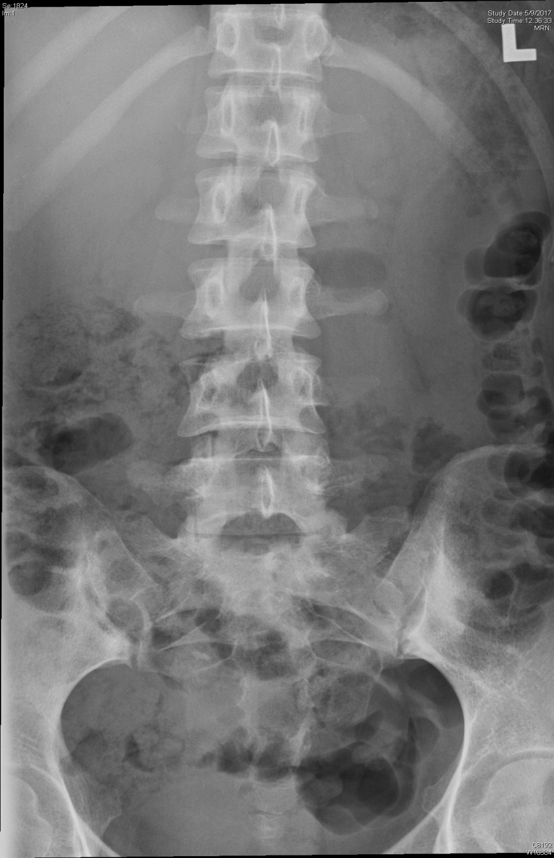
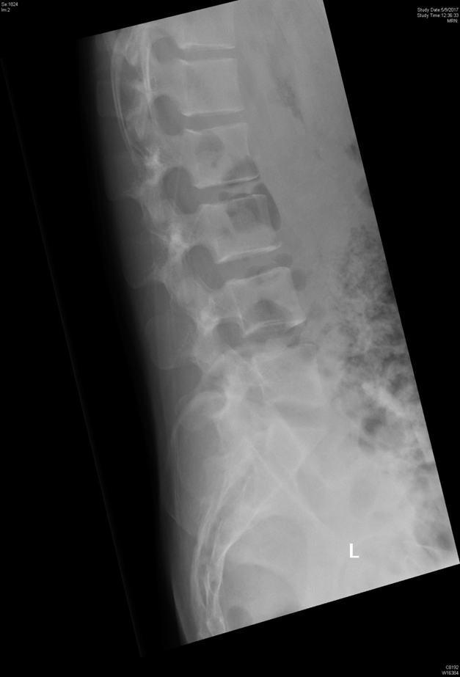

Slide 20
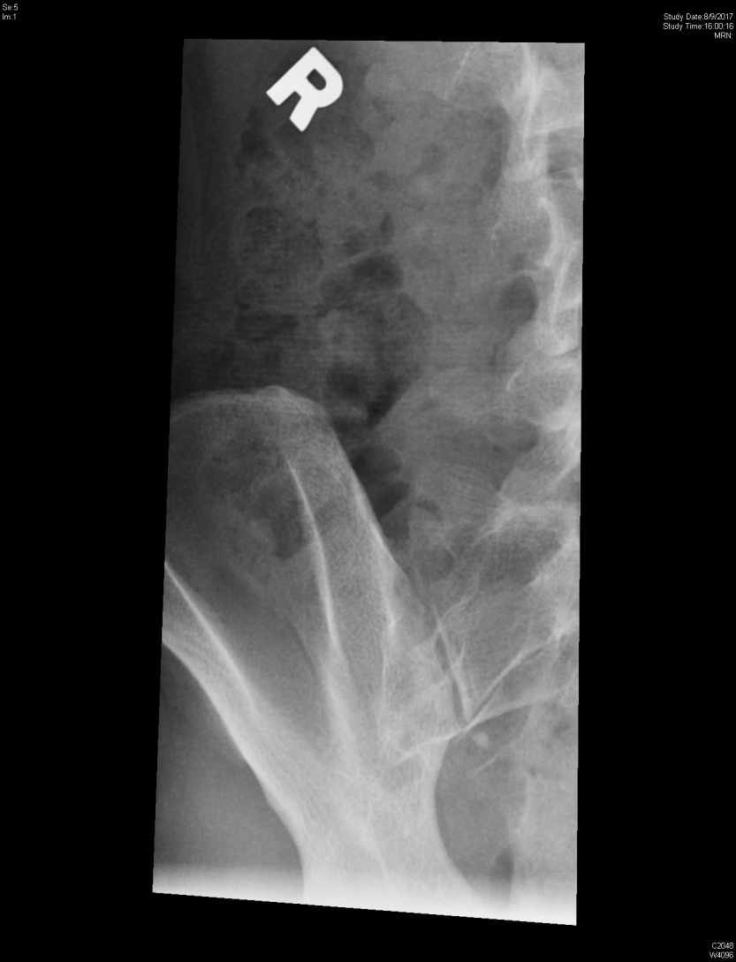
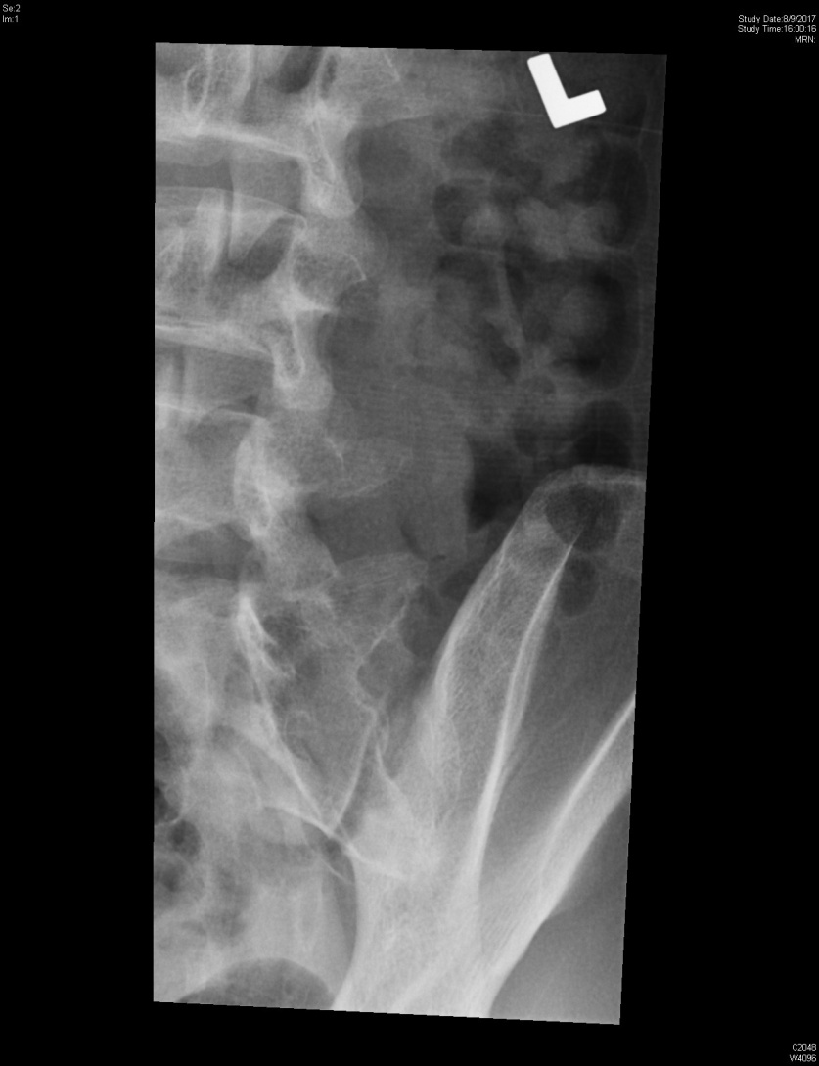
Both oblique view

Slide 21
Question
Name FOUR “red flags” of low back pain (2)
Describe TWO XR findings. What is the most possible diagnosis? (2)
Name ONE test to examine this patient bearing your suspected diagnosis (1)
Suggest ONE important blood tests that should be helpful for this patient for diagnosis and management (1)
Name TWO extra-articular manifestations of the condition? (2)
Give TWO management modalities for this condition? (2)

Slide 22
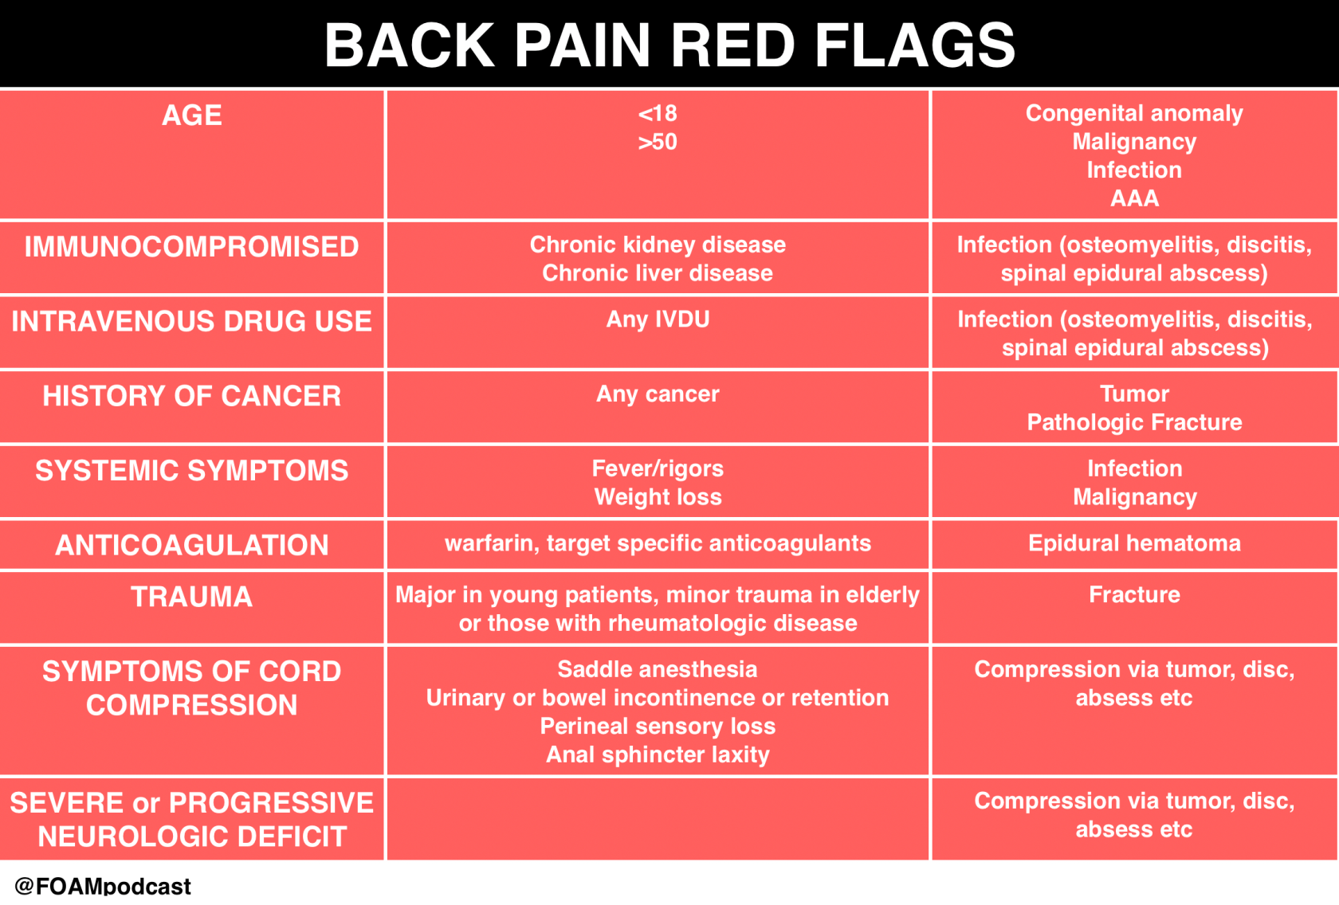
Answers

Slide 23
Answers
(previous slide)
X-ray abnormality
  Sclerosis are seen over both sacroiliac joint.
  On oblique SI Joint view, bony erosion is evident at Lt side.
The finding is suggestive of sacroiliitis. The most common cause of sacroiliitis is ankylosing spondylitis.
(next slide)
HLA B27 typing & Inflammatory marker e.g. C-reactive protein
Uveitis, Inflammatory bowel disease, Psoriasis, Apical pulmonary fibrosis, Aortic regurgitation and , conduction abnormalities.
Physiotherapy, NSAID, Tumor Necrosis Factor inhibitors e.g. Infliximab
Notes:
According to a study, the frequency of HLA B27 ranged from 24.3-46.7% as in Chinese patients with 2.4% in healthy control

Slide 24
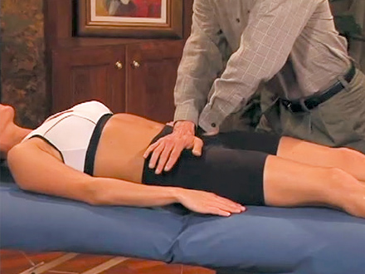
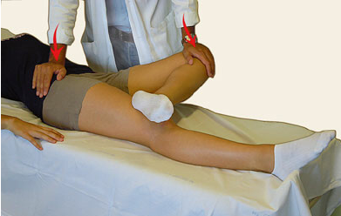
How do you exanimate the relevant area?
Anterior gapping test
(Sacroiliac distraction test)
Faber test
(Flexion, Abduction and External Rotation)

Slide 25
Q5
F/ 25
Brought in by ambulance for decreased level of consciousness.
Initial vitals: BP 80/50, HR 150, SpO2 97% on 4L O2, GCS E1V1M1
These are the initial blood test results
FIO2 0.3
pH 6.9
pCO2 10 mmHg
pO2 147 mmHg
Bicarbonate 2 mmol/L
Base excess -30
SaO2 saturation 98 %
Lactate 7.1 mmol/L
Na+ 140 mmol/L
K+ 6.0 mmol/L
Cl- 105 mmol/L
Creatinine 70 µmol/L
Urea 4.8 mmol/L
Glucose 5.2 mmol/L
Osmolality 360 mOsm/L

Slide 26
Questions
Identify the complete acid base abnormality in the above blood results (3)
Identify TWO other abnormalities in the above blood results (2)
Name TWO more laboratory tests that are indicated to aid in diagnosis (2)
Name one differential diagnosis (1)
The patient has gone into cardiac arrest shortly after intubation and mechanical ventilation. Suggest TWO measure to prevent peri-intubation cardiac arrest in this patient. (2)

Slide 27
Answers
High anion gap; metabolic acidosis; incomplete respiratory compensation
Hyperkalaemia, hyperlactaemia, high osmolar gap
Ethanol levels, ketone (BHBA) level
Alcoholic ketoacidosis, toxic alcohol toxicity
Measures
  Fluid resuscitation
  HCO3 infusion (to reduce metabolic acidosis prior to intubation) or
  Adequate ventilation/Bagging during RSI by skilled operator (to reduce apnea period and associated rise in pCO2)
  Allow spontaneous mode of mechanical ventilation to maintain respiratory compensation for acidosis

Slide 28
Q6
M/ 19 involved in an high speed road traffic accident with deformed lower limbs. His lower body was trapped between two cars. His initial vitals are:
BP 70/40, HR 140
GCS E4V5M6
SpO2 100% on RA
Fast Scan was Positive, initial CXR and lung USG was normal.
Unmatched blood was given during resuscitation in the ED.

Slide 29
Q6
1) Name THREE acute non-immune mediated transfusion related complications (3)
He began to desaturates and complains of shortness of breathe after 3 units of blood was given
2) Name TWO possible causes of his shortness of breathe. (2)
He was rushed to the operating room for immediate laparotomy and external fixation of pelvis. His bleeding was found to be difficult to control with microvascular ooze.
3) Name THREE measures that can be employed in the ED to reduce acute trauma coagulopathy (3)
4) Give TWO additional measure that should be employed during transfusion if the patient is undergoing chemotherapy for bone marrow transplant? (2)

Slide 30
Answers
Hypothermia, Hyperkalaemia, Hypocalcaemia, Sepsis, Transfusion Associated circulatory overload (TACO), dilutional coagulopathy
Transfusion related acute lung injury, TACO, Acidosis due to shock
Measures
  Stop ongoing bleeding, permissive hypotension, keep normothermia (blood warmer, fluid warmer, radiant heater, etc)
  Avoid dilution of coagulation factors (High plasma to red cell ratio transfusion, massive transfusion protocol, replacement of clotting factors, etc),
  Address hyperfibrinolysis (give Transamin)
  Address hypocalcaemia, acidosis, shock
WBC filter or leucocyte reduced blood

Slide 31
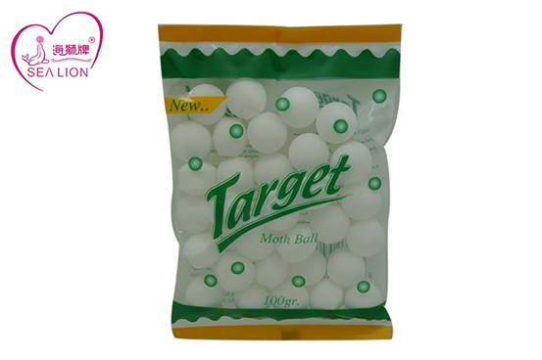
Q7
M/3 brought to AED by his mother suspected taken mothballs 1/2 hour ago. He is currently well.

Slide 32
Questions
What are the common active ingredients inside mothballs? (3)
Describe a bedside test available in Emergency Department to differentiate different types of mothballs? (3)
The boy suddenly developed generalized tonic- clonic convulsion.
What is the most likely cause? (1)
What is the toxic dose? (1)
Outline 2 modalities of management? (2)

Slide 33
Answers
Camphor, Naphthalene, Paradichlorobenzene
Float test
  Camphor floats in water and saturated salt solution or D50 solution,
  Naphthalene floats only in saturated Salt / D50 solution but not water,
  Paradichlorobenzene does not float in both water nor saturated salt or D50 solution
The moth ball likely contains camphor.
Toxic dose 30mg/kg
Management outline
  Airway protection with endotracheal intubation
  Gastric lavage after airway protection, activated charcoal 1g/Kg
  Benzodiazepines for seizure control
  Admit PICU for close monitoring.

